Slide 1
XGBoost Tree-Based Prediction of Vaccine Response Metrics
Liran Mao, Lexi Li, Tram Anh Nguyen, Yuhao Tan
University of Pennsylvania

Slide 2
Introduction & Motivation
Whooping cough (pertussis) remains a public health concern, particularly due to waning immunity from acellular pertussis (aP) vaccines.
Immune responses to booster vaccines vary significantly between individuals, influenced by:
Pre-existing immunity
Age, sex, and genetic factors
Baseline immune signatures
Understanding these variations can help in personalized vaccine strategies and improving immunization schedules.

Slide 3
Project Goal and Challenge results
Predict B. pertussis vaccination outcomes
IgG-PT antibody levels
Rank: 0.114 (Point: 0)
Fold change: -0.033 (Point: 0)
Monocyte frequencies
Rank: 0.572 (Point: 1)
Fold change: 0.408 (Point: 8)
CCL3 gene expression
Rank: 0.578 (Point: 6)
Fold change: 0.311 (Point: 6)

Slide 4
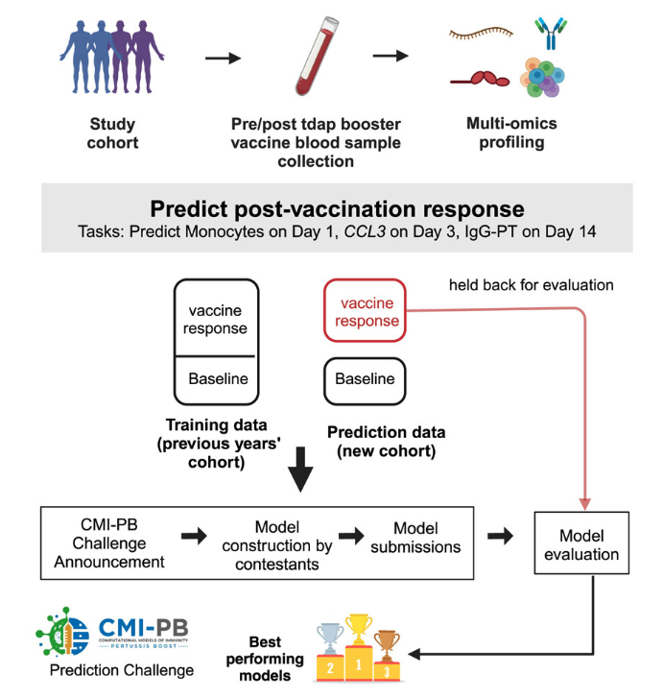
CMI-PB Data
Demographic data
Antibody measurements
Cytokine and chemokine concentration
Gene expression
Cell type frequencies
T cell polarization and activation
Multiple time points (before and after vaccination)
Notes:
Thanks to CMI-PB challenge to provide this valuable dataset for us to explore.

Slide 5
Feature selection
Demographics: age at boost, biological sex, infancy vaccination status
Baseline measurements (Day 0): Monocytes, CCL3, IgG-PT
Tried to use more features and tried PCA and MCIA, but didn’t perform well in cross-validation
Limited sample size and lots of missing values
Notes:
Feature Selection Strategy
Why these features?
Based on previous challenge projects & example codes
LOOCV performance evaluation led to excluding some features
MCIA model was tested but didn’t perform well

Slide 6
Feature Processing
Log2 transformation for gene expression and fold change response
Tried log2 on other omics but did not work well
Missing values: Median imputation
Notes:
The reason why we selected those features is that we evaluated the projects from previous challenges and example code and found these features have good prediction power. Also, we tried to include more data provided, and they didn’t seem to perform well when we used Leave-One-Out Cross-Validation (LOOCV) to evaluate. For example, we tried Multiple Co-Inertia Analysis (MCIA) model to deal with omics and cell frequency data but it’s not working that well.

Slide 7
Model Development
Leave-one-out cross validation
Training loss: RMSE
Evaluation: Pearson correlation
Notes:
To choose the best model to use, we implemented a comprehensive model evaluation framework incorporating ten distinct algorithms:
Linear Models: Standard Linear Regression, Lasso Regression (α=1), Ridge Regression (α=0), Elastic Net (α=0.1-0.9)
Non-linear Models: Random Forest. Support Vector Machines, Gradient Boosting, XGBoost
We used Leave-One-Out Cross-Validation (LOOCV) to evaluate the model considering the limited number of data. Root Mean Square Error (RMSE) served as the optimization metric during training, while correlation between predictions and observations was used for performance comparison.

Slide 8
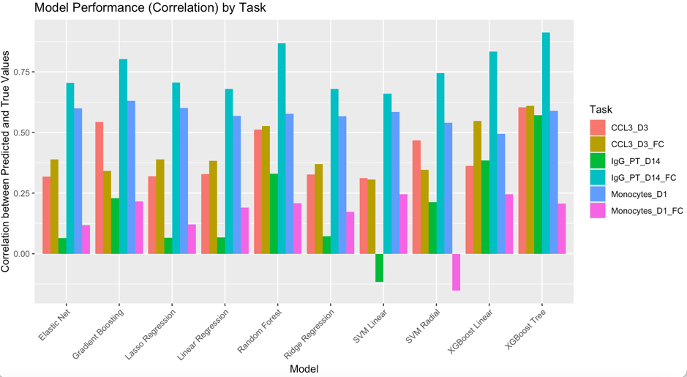
XGBoost tree performs the best
Challenge results
0.578 (Point: 6)
0.311 (Point: 6)
0.114 (Point: 0)
-0.033 (Point: 0)
0.572 (Point: 1)
0.408 (Point: 8)
Notes:
XGBoost Tree consistently demonstrated superior performance across multiple prediction tasks. Model performance varied notably between direct measurements and fold-change predictions, suggesting different underlying biological mechanisms may govern these responses. But we do think we are limited by the limited number of features we use. Future work could focus on incorporating additional immunological parameters and exploring deep learning approaches for capturing complex interactions between immune system components and this might need more data collected.

Slide 9
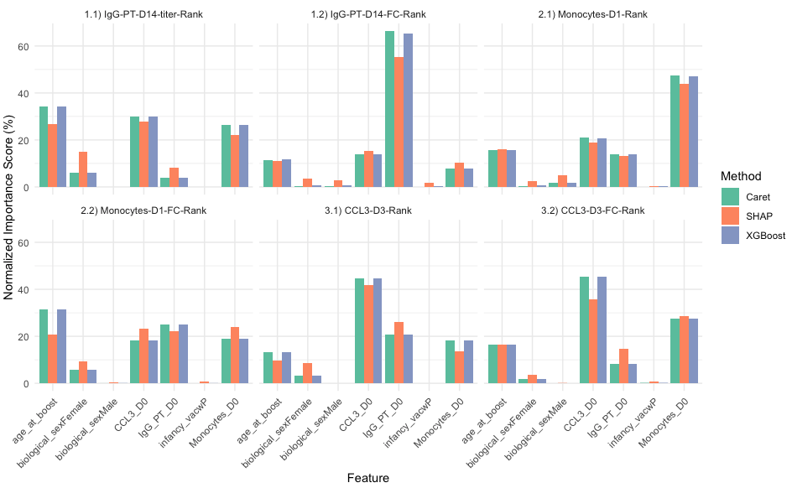
Feature contribution
Caret (Permutation Importance
SHAP (Shapley Additive Explanations)
XGBoost Built-in Feature Importance
Notes:
Overall, I think all three methods (Caret, SHAP, XGBoost) generally agree on feature importance rankings. For all taks, demographic features (age_at_boost, biological_sex) show moderate importance, while infancy_vacwP has minimal impact across all tasks.
For absolute value prediction, I think it makes sense to see baseline measurements (D0) are consistently important for predicting their D1/D3/D14 outcomes. However, FC tasks show slightly different patterns than their raw value counterparts, suggesting different predictive mechanisms for absolute vs relative changes.

Slide 10
Feature contribution
wP/aP is not important
Notes:
Overall, I think all three methods (Caret, SHAP, XGBoost) generally agree on feature importance rankings. For all taks, demographic features (age_at_boost, biological_sex) show moderate importance, while infancy_vacwP has minimal impact across all tasks.
For absolute value prediction, I think it makes sense to see baseline measurements (D0) are consistently important for predicting their D1/D3/D14 outcomes. However, FC tasks show slightly different patterns than their raw value counterparts, suggesting different predictive mechanisms for absolute vs relative changes.

Slide 11
Feature contribution
wP/aP is not important
Age/sex are important for some tasks
Notes:
Overall, I think all three methods (Caret, SHAP, XGBoost) generally agree on feature importance rankings. For all taks, demographic features (age_at_boost, biological_sex) show moderate importance, while infancy_vacwP has minimal impact across all tasks.
For absolute value prediction, I think it makes sense to see baseline measurements (D0) are consistently important for predicting their D1/D3/D14 outcomes. However, FC tasks show slightly different patterns than their raw value counterparts, suggesting different predictive mechanisms for absolute vs relative changes.

Slide 12
Feature contribution
wP/aP is not important
Age/sex are important for some tasks
Baseline values are sometimes the most important
Notes:
Overall, I think all three methods (Caret, SHAP, XGBoost) generally agree on feature importance rankings. For all taks, demographic features (age_at_boost, biological_sex) show moderate importance, while infancy_vacwP has minimal impact across all tasks.
For absolute value prediction, I think it makes sense to see baseline measurements (D0) are consistently important for predicting their D1/D3/D14 outcomes. However, FC tasks show slightly different patterns than their raw value counterparts, suggesting different predictive mechanisms for absolute vs relative changes.

Slide 13
Feature contribution
wP/aP is not important
Age/sex are important for some tasks
Baseline values are sometimes the most important
Baseline IgG, CCL3, and monocytes are generally important
Notes:
Overall, I think all three methods (Caret, SHAP, XGBoost) generally agree on feature importance rankings. For all taks, demographic features (age_at_boost, biological_sex) show moderate importance, while infancy_vacwP has minimal impact across all tasks.
For absolute value prediction, I think it makes sense to see baseline measurements (D0) are consistently important for predicting their D1/D3/D14 outcomes. However, FC tasks show slightly different patterns than their raw value counterparts, suggesting different predictive mechanisms for absolute vs relative changes.

Slide 14
Challenges & Limitations
Data Limitations
Small Sample Size (~119 training samples, 54 test samples)
Missing Values
Batch effects
Feature Redundancy & Selection
Model Performance Constraints
Differences Between Absolute & Fold-Change Predictions
Notes:
Data Limitations
Small Sample Size:
The dataset is relatively small (~119 training samples, 54 test samples), making it prone to overfitting and limiting the generalizability of models.
Leave-One-Out Cross-Validation (LOOCV) was used, but larger datasets would improve model stability.
Missing Values:
Some features had missing data, requiring imputation (median-based or MICE), which might introduce bias.
Certain features had low variance and had to be filtered out, potentially removing useful signals.
Feature Redundancy & Selection:
The dataset contains high-dimensional features (~58,000 features), requiring careful feature selection to prevent noise from degrading model performance.
The challenge of balancing multi-omics integration while avoiding overfitting remains.
Differences Between Absolute & Fold-Change Predictions:
Models for absolute values performed well using baseline immune markers, but fold-change (FC) tasks exhibited different feature importance patterns, suggesting the need for task-specific models.
This suggests different underlying biological mechanisms for absolute vs. relative changes.
Influence of Simple Features:
Surprisingly, age at boost remained one of the strongest predictors, as noted in previous CMI-PB challenges.
This raises concerns that some non-omics features (e.g., age, sex) may dominate predictions over complex molecular biomarkers.
Generalizability & Biological Interpretability
Limited External Validation:
The model was tested on one dataset, but its generalizability to other vaccine responses or real-world clinical settings is unclear.
Future work should evaluate models on independent cohorts.
Mechanistic Understanding:
While XGBoost provides accurate predictions, it remains a black-box model, making it harder to derive clear biological insights from feature contributions.
Incorporating interpretable ML methods (e.g., SHAP, pathway-based models) may improve mechanistic understanding.

Slide 15
Future directions
Expand Training Data – Incorporate more samples across multiple cohorts.
Improve Feature Selection/Engineering – Explore domain-specific biomarker selection rather than relying on generic ML feature importance.
Explore Deep Learning – Advanced architectures could better capture complex, nonlinear immune interactions (if more data becomes available).
Enhance Biological Interpretability – Use network-based models, Bayesian approaches, or pathway-based methods to improve insight into immune system interactions.

Slide 16
Acknowledgments
Special thanks to:
CMI-PB Challenge organizers
All team members
Notes:
I would like to express my sincere gratitude to the CMI-PB Challenge organizers for providing this unique opportunity to advance computational modeling in vaccinology.
And all team members

Slide 17
Thank you!

