Slide 1

CyTOF – Panel and gating strategy
Training dataset

Slide 2
List of antibodies used in the CyTOF panel
Note that CD4 and CD20 were coupled with the same metal – However through as these markers are specific for T cells (CD4) and B cells (CD20), they are separated in parent gates during the analysis: CD3+ for T cells and CD19+ for B cells.

Slide 3
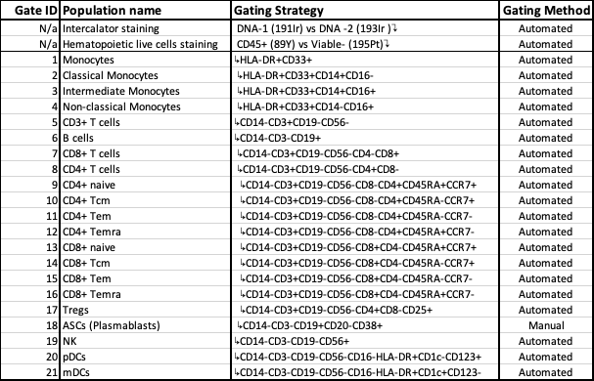
Table with detailed phenotypes
NOTE: Excel attached

Slide 4
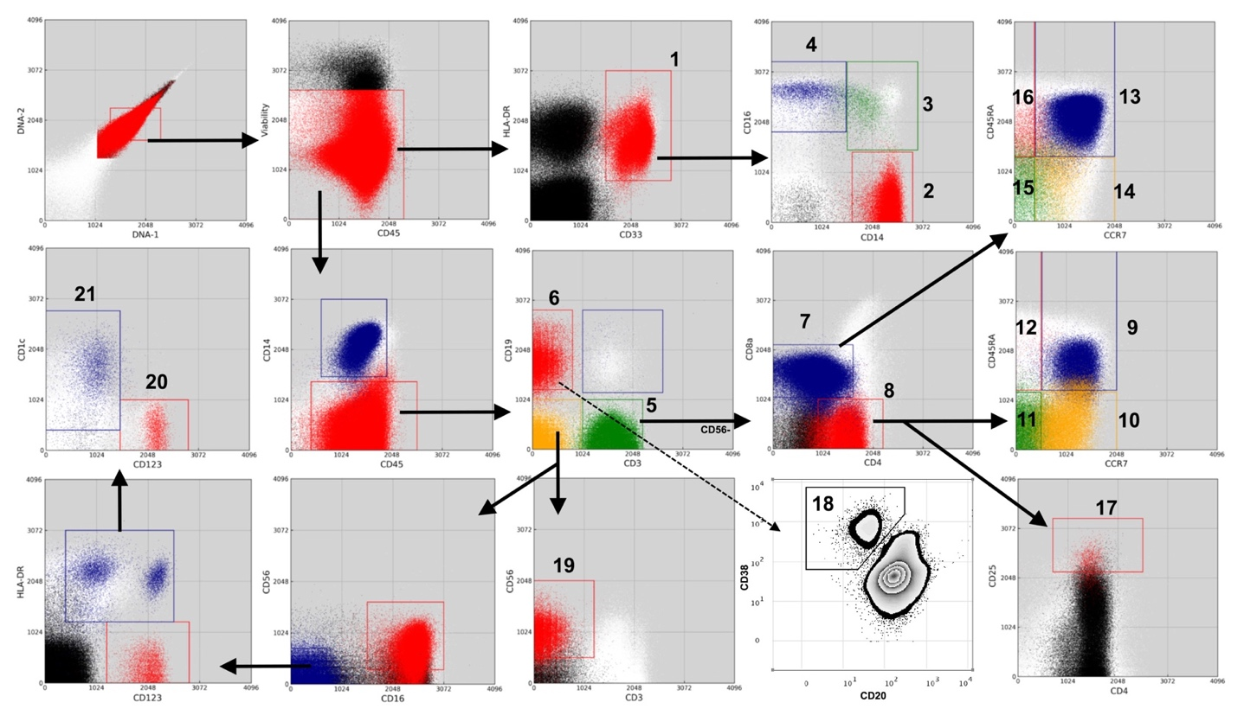
Gating strategy
Identification of immune cell subsets in human PBMCs by CyTOF.
Each number (Gate ID) represents a major population or subset.
Monocytes
Classical Monocytes
Intermediate Monocytes
Non-classical Monocytes
CD3+ T cells
B cells
CD8+ T cells
CD4+ T cells
CD4+ naïve
CD4+ Tcm
CD4+ Tem
CD4+ Temra
CD8+ naïve
CD8+ Tcm
CD8+ Tem
CD8+ Temra
Tregs
ASCs (Plasmablasts)
NK cells
pDCs
mDCs.

Slide 5
Parameters to be provided
2020 dataset

Slide 6
Parameters to be provided
Number of donors: We will do at least 10 donors per group
  19 aP
  19 wP
Techniques/timepoints:
  Bulk PBMC transcriptomics: 0, 1, 3, 7, 14 days post boost
  Cell frequencies: 0, 1, 3, 7, 14 days post boost
  Plasma proteomics: 0, 1, 3, 7, 14 days post boost
  Antibody responses: 0, 1, 3, 7, 14, 30 and 90 days post boost
  T cell responses: Day 0 and 30 post boost.

Slide 7
Cell frequencies - Flow Cytometry Panel and Gating Strategy
Antibodies
CD56^{high} NK cells
CD56⁺ NK cells
CD56⁺ T cells
CD56⁺ CD3^{high} T cells
CD8 T cells
CD4 T cells
CD8 TEMRA
CD8 Naïve
CD8 TEM
CD8 TCM
CD4 TEMRA
CD4 Naïve
CD4 TEM
CD4 TCM
B cells
Naïve B cells
Memory B cells
Plasmablasts
Activated B cells
Classical Monocytes
Intermediate Monocytes
Non-classical Monocytes
pDCs
Conventional DCs
Basophils
Activated granulocytes
Panel allows to identify 26 cell subsets

Slide 8
Plasma proteomics - OLINK - PEA 48-plex
Absolute quantification in plasma
48 cytokines/chemokines
(Excel file attached)

Slide 9
Antibody isotype and antigen specificity
We will evaluate the following antigen -specificity:
  TdaP Antigens:
    Pertussis Antigens:
      FHA(Filamentous Hemagglutinin)
      Fim2/3 (Fimbriae 2 and 3)
      PRN (Pertactin)
      PTx (Pertussis Toxoid)
    Other antigens in the vaccine:
      DT (Diphtheria Toxoid)
      TT (Tetanus Toxoid)
  Negative control antigens:
    Irrelevant OVA
    PD1
  Isotypes:
    Qualitative measures (by MFI)
      IgE
      IgG
      IgG1
      IgG2
      IgG3
      IgG4
      IgA
      IgM
    Quantitative measures (IU/ml)
      PT-specific total IgG
      PRN-specific total IgG
      FHA-specific total IgG
      Total IgE
In green, those are the measures that will be provided
In black, potential inclusions
The data will be provided as in the training dataset (qualitative using MFI units)
See attached Excel example of the minimum readouts we will generate

Slide 10
T cell responses
We will provide data of:
  T cell polarization with FLUOROSPOT → Readouts: IFN-γ, IL-17 and IL-5
  We will evaluate magnitude of response by assessing the number of antigen Specific T cells ex vivo with AIM assay
  Both approaches will be performed with the same stimulations
Guaranteed evaluation of responses against the following antigens:
  Pertussis megapool (PT MP) → Contains peptides of 4 vaccine antigens; FHA(Filamentous Hemagglutinin), Fim2/3 (Fimbriae 2 and 3), PRN (Pertactin) and PTx (Pertussis Toxin)
  Tetanus megapool (TT MP) → Peptides of Tetanus Toxoid
A more detailed evaluation of individual peptides is under development and we will update in the feasibility in the future.

Slide 11
Notes
This data is the minimum we want to generate
Future cohorts will include exactly the same readouts for consistency
New approaches and readouts are being developed and could potentially be included in the grant (To be discussed)

