Slide 1
3rd CMI-PB Prediction Challenge
Jian Xing, Burhan Sabuwala
Advised by Leying Guan
Yale University

Slide 2
Yale Team & Participation
3rd Challenge:
Jian Xing: Lasso regression prediction model
Burhan Sabuwala: SPEAR prediction model
History:
Anna Konstorum: MCIA prediction model
Jeremy Gigi : SPEAR prediction model

Slide 3
Data Preprocessing and Goals

Slide 4
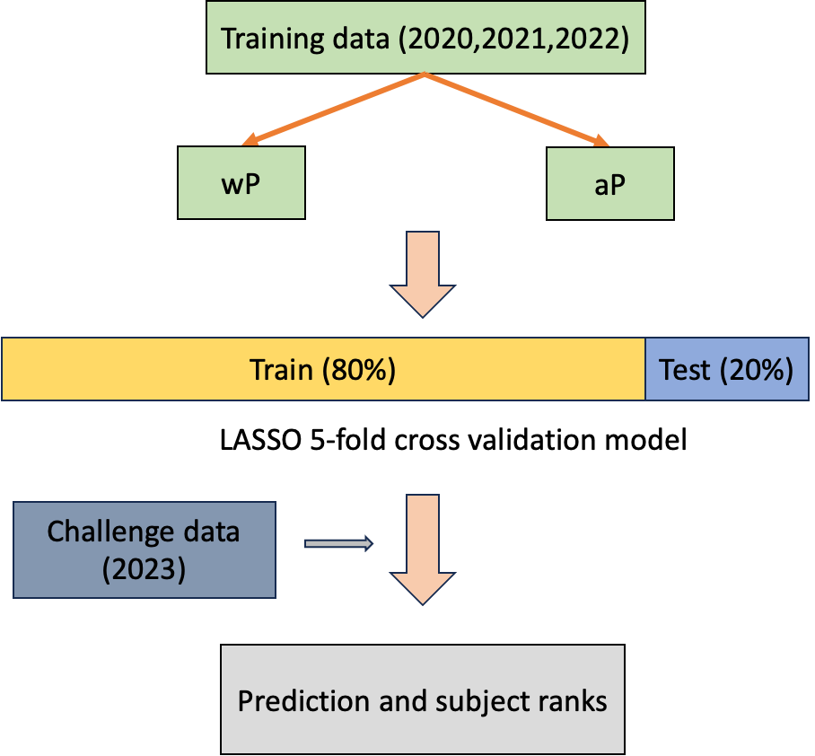
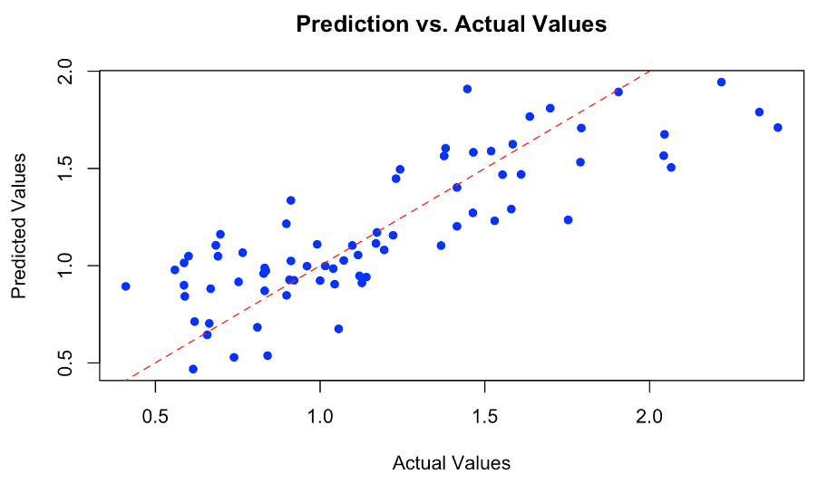
Lasso Regression Prediction Model

Slide 5
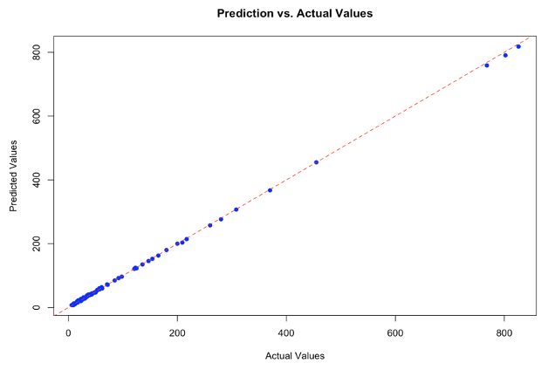
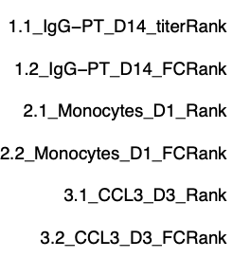
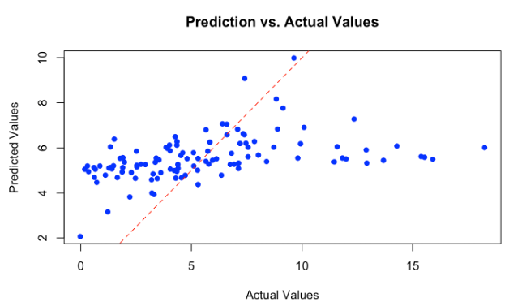
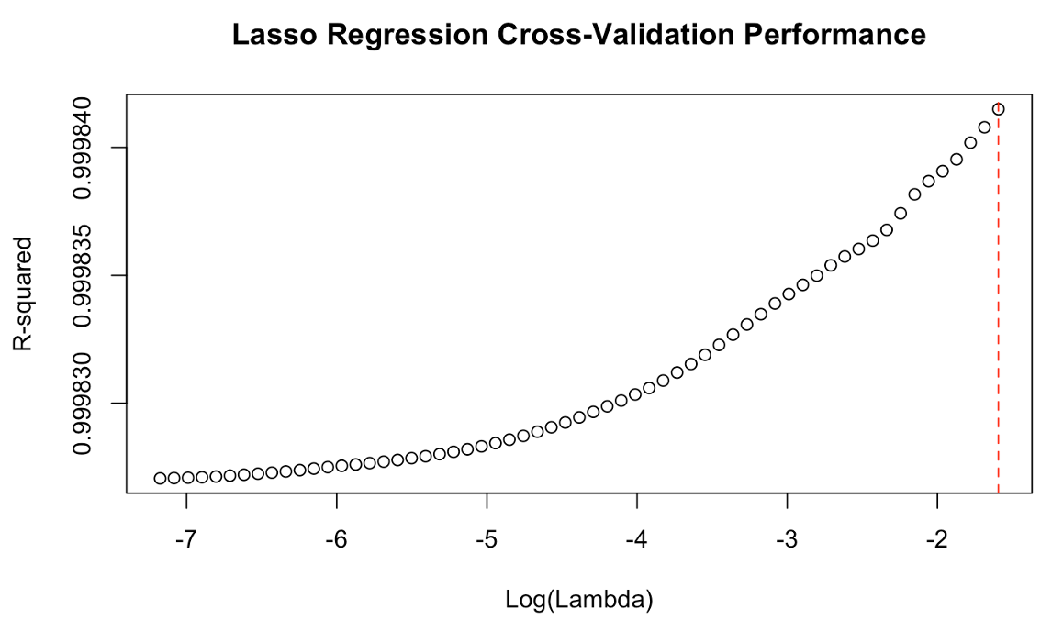
Performance of Lasso Regression Prediction Model
Task 1
Task 3
Task 2

Slide 6
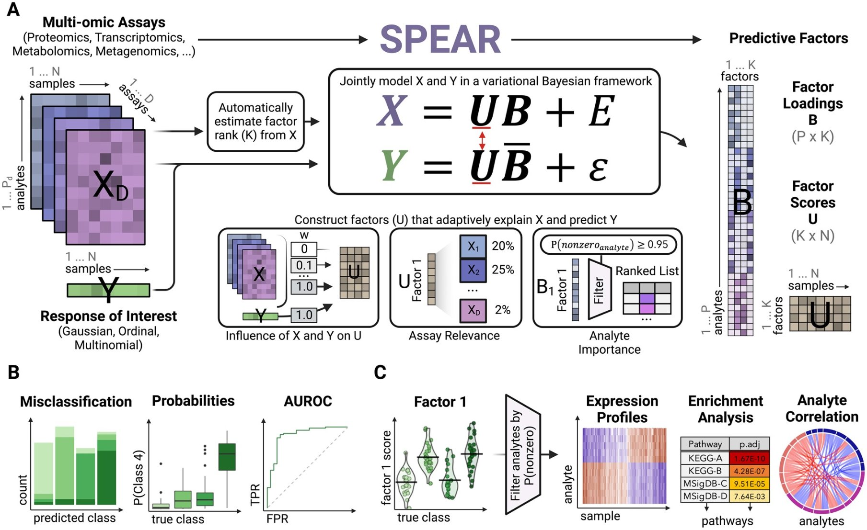
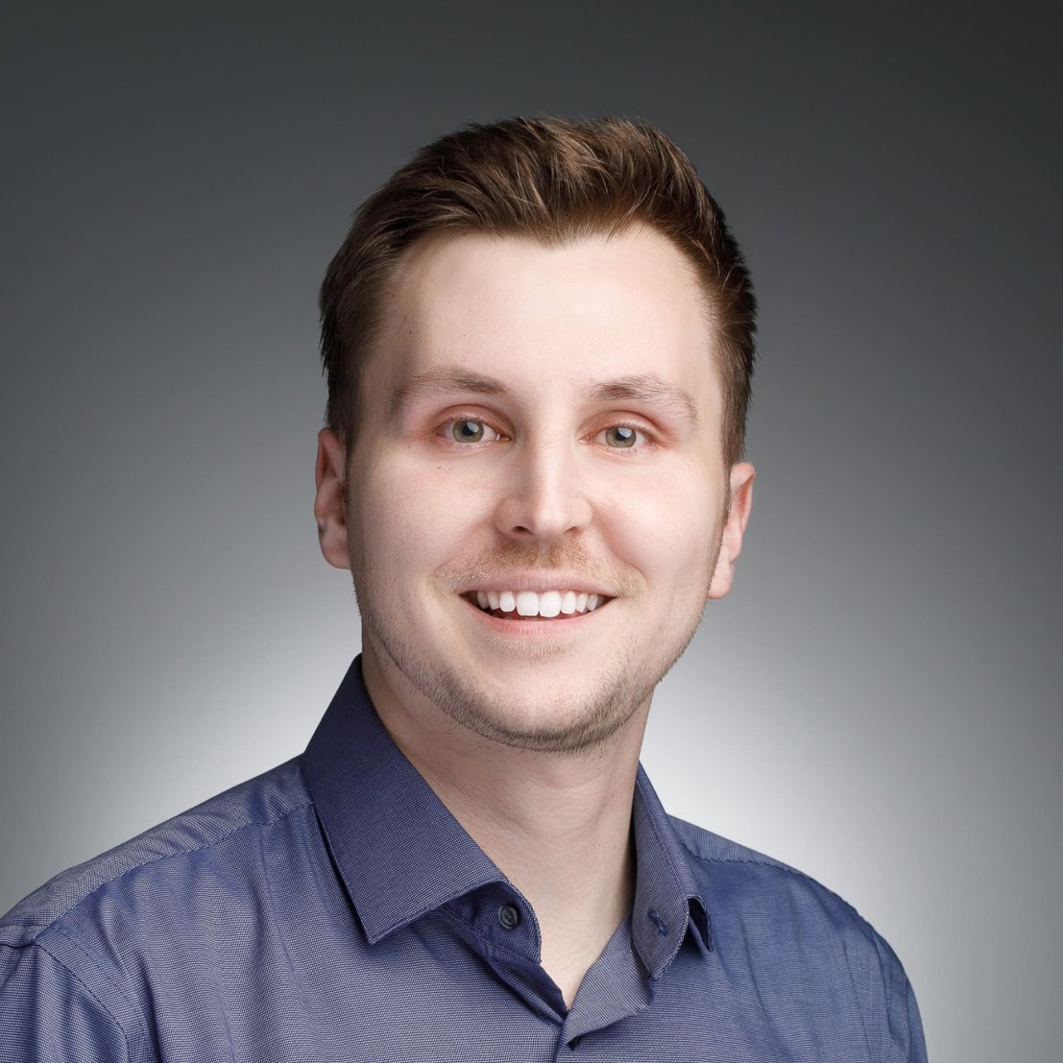
Signature-based multiPle-omics intEgration via LAtent factoRs (SPEAR)
Gygi et al. Bioinformatics 2024

Slide 7
Prediction Strategy

Slide 8
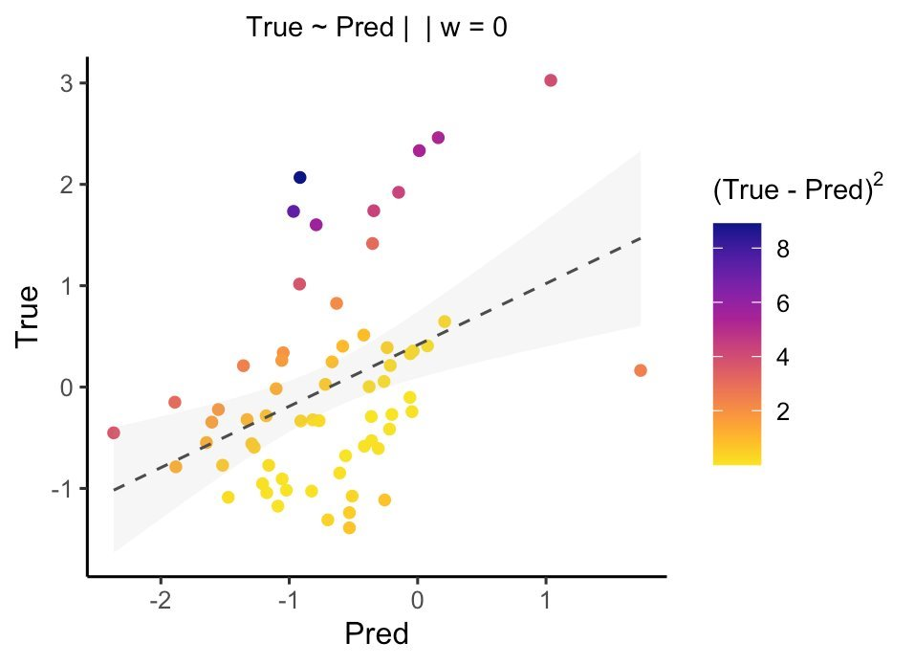
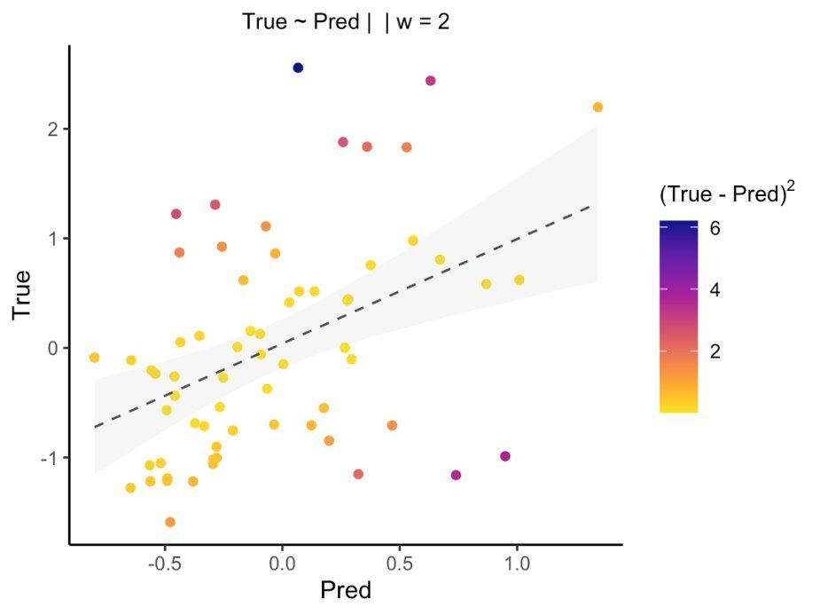
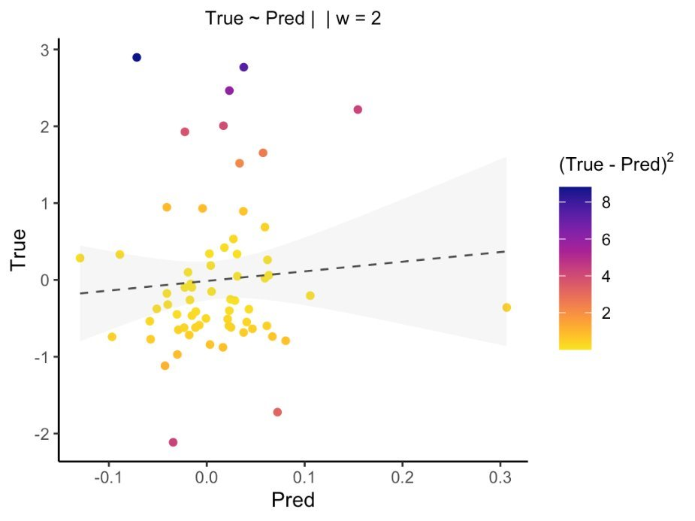
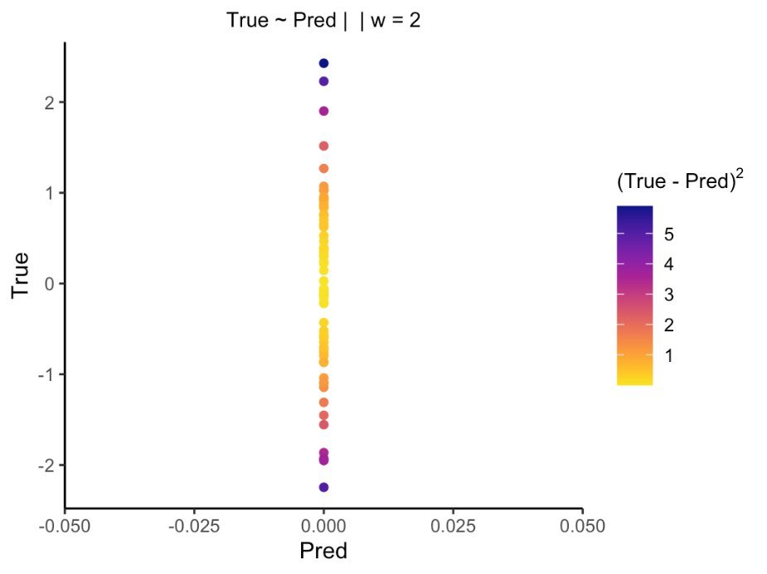
Performance of SPEAR + LASSO model
Task 1 Antibody Titer at Day 14
Task 2 Monocyte freq at Day 1
Absolute Value
Fold Change

