Slide 1
Using JIVE for jDR and Tasks Prediction in CMI-PB Challenges
Cemil Can (JJ) Ali Marandi - Ay Lab
February 28th 2025

Slide 2
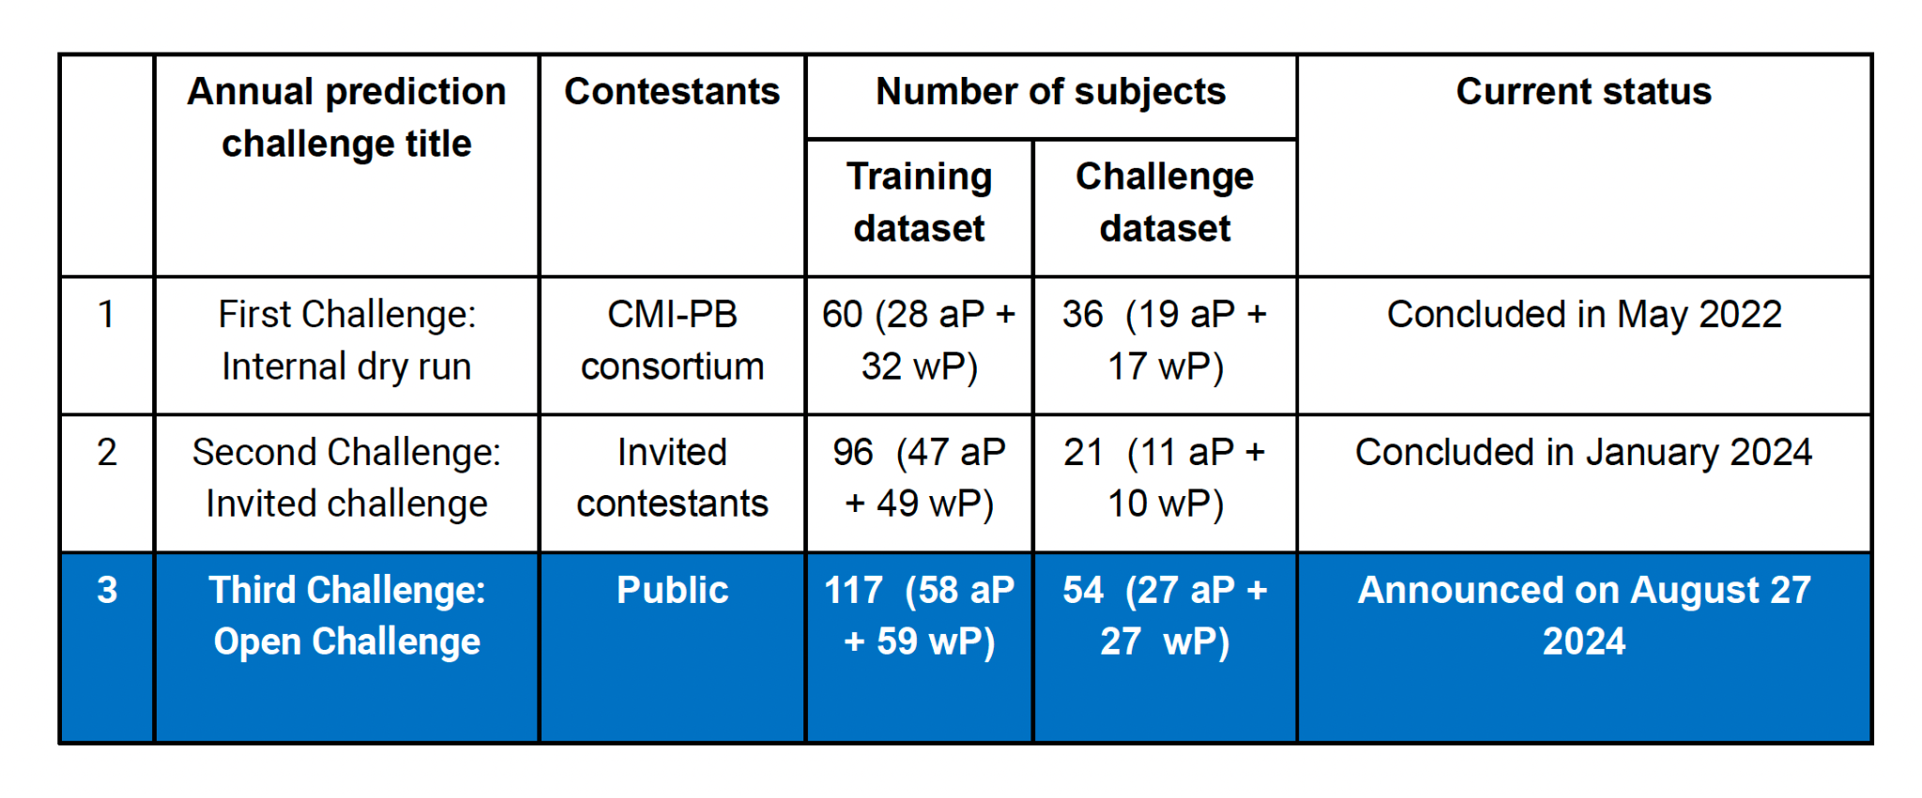
Overview of CMI-PB Annual Prediction Challenges
Source: 9/6/24 CMI-PB 1st Informational Session slides

Slide 3
Prediction Task Categories and Descriptions
Task Category | Task 1 | Task 2
Antibody Titer Tasks | Rank individuals by IgG antibody titers against pertussis toxin (PT) 14 days post booster | Rank individuals by the fold change of IgG titers (post booster vs. baseline [Day 0])
Cell Frequency Tasks | Rank individuals by the predicted frequency of Monocytes on Day 1 post booster | Rank individuals by the fold change in Monocyte frequency (post booster vs. baseline)
Gene Expression Tasks | Rank individuals by predicted gene expression of CCL3 on Day 3 post booster | Rank individuals by the fold change in CCL3 expression (post booster vs. baseline)
*Bonus Task (T-cell) |  | Optional: Rank individuals by their Th1/Th2 (IFN-γ/IL-5) polarization ratio on Day 30 post booster
*Did not attempt the Bonus Task (T-cell)

Slide 4
Overview of Multi-omics Data Types Provided
Data Type | Measurement Method | Details/Assays
PBMC Cell Frequencies | Flow Cytometry | Quantification of 37 distinct immune cell populations
Antibody Titers | Luminex Assays | Measurement of multiple IgG isotypes (IgG, IgG1, IgG2, IgG3, IgG4) against vaccine antigens (e.g., PT, PRN, FHA, FIM2/3, TT, DT, and control antigen OVA)
Plasma Proteomics | Olink & Legendplex | Concentrations of 48 cytokines
PBMC Transcriptomics | Bulk RNA-Seq | Gene expression profiling across thousands of genes
Antigen-specific T Cell Responses | AIM Assay & FluoroSpot | Evaluation of CD4+ T cell activation (e.g., % OX40+CD25+ cells) and cytokine polarization (IFN-γ, IL-5, IL-17)

Slide 5
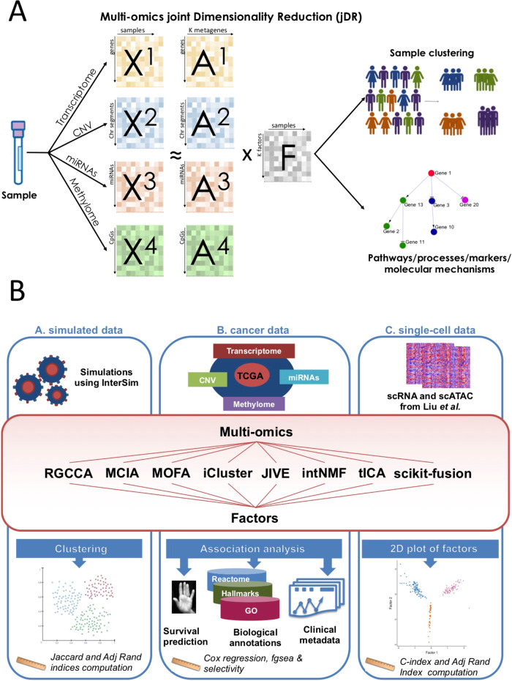
Overview of the multi-omics approach and further applications
Focus on the cancer results which is most relevant to CMI-PB

Slide 6
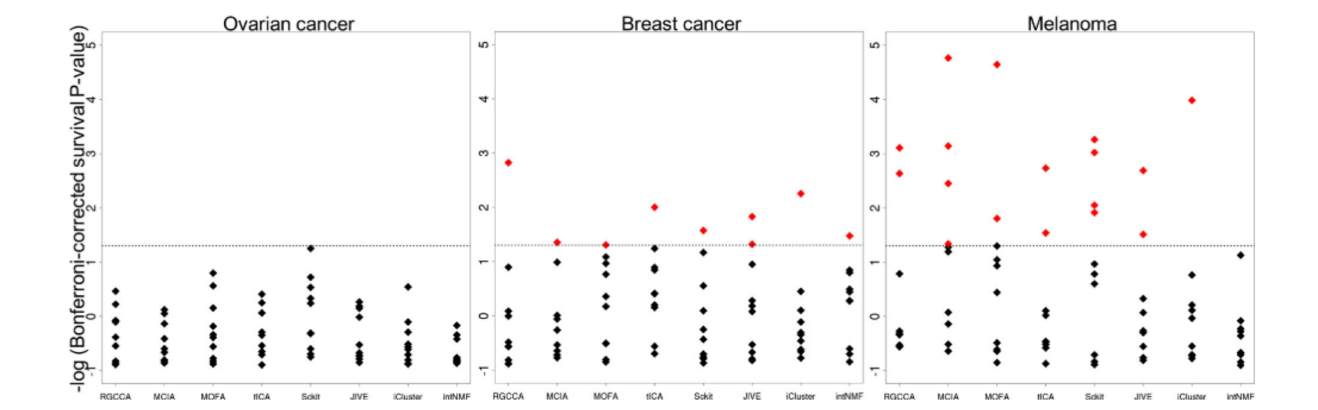
Survival analysis using 8 multiomics DR methods
Results are more dependent on the data rather than the method

Slide 7
High-Level Overview of the Pipeline
Harmonized Data from Assays
Data Cleaning & Aggregation
Run JIVE Decomposition on Harmonized Data
Train & Evaluate Predictive Models
Performance Visualization & Analysis

Slide 8
Overview of JIVE Decomposition
Input Data: Harmonized, processed matrices for each assay (training data only)
Common Samples: Intersection of samples across all assays (identified and saved)
Decomposition: JIVE algorithm separates data into joint factors (shared signals) and individual assay-specific components
Outputs: Global JIVE factors (for each sample) and loadings (metagenes) for each assay

Slide 9
JIVE
X_{cytof}
Harmonized data
Calculate Loading and Factor Matrices
k=10
X_{olink}
X_{rnaseq}

Slide 10
Y is the outcome or response variable
X is the input or predictor data
M is a matrix of coefficients that maps X to Y
β is the intercept (or bias) term
ε is the error term, capturing noise or unexplained variation
Training Different Models with JIVE Factors
Factors
Train Different Models Using Factor Matrices
X_{cytof}
Concatenate Factors
Y = MX + 𝛃 + 𝜺
Linear Regression
Lasso
Elastic Net
Lasso with CV
Elastic Net with CV
Factors
Factors
Factors
Factors
X_{olink}
Factors
X_{rnaseq}
Predictions

Slide 11
Lasso Results

Slide 12
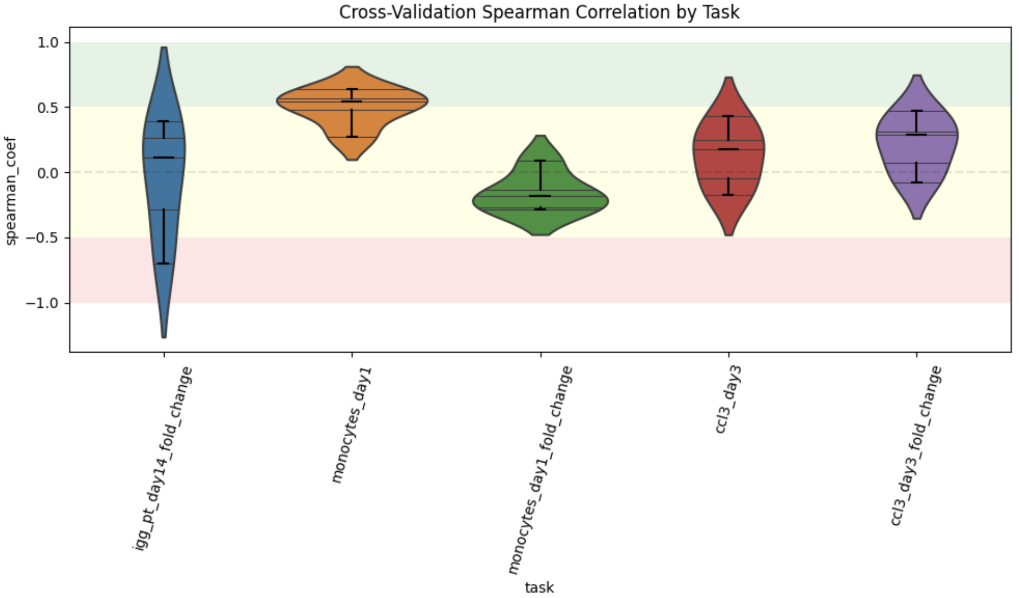

Slide 13
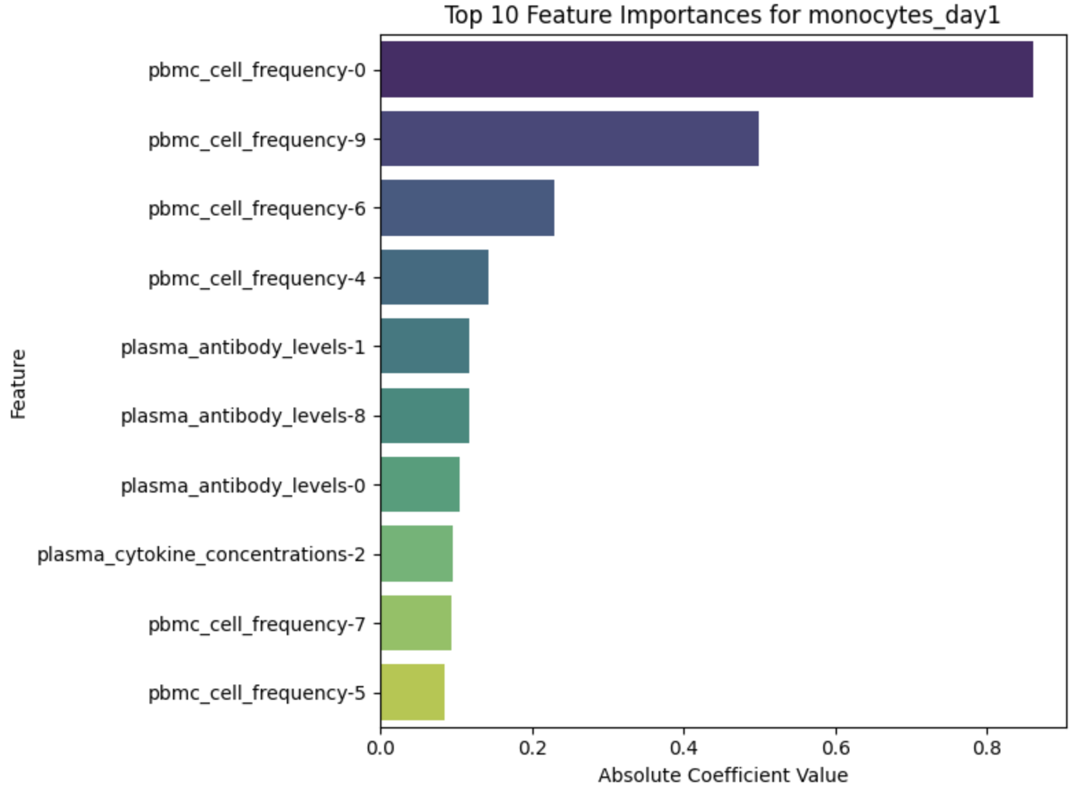

Slide 14
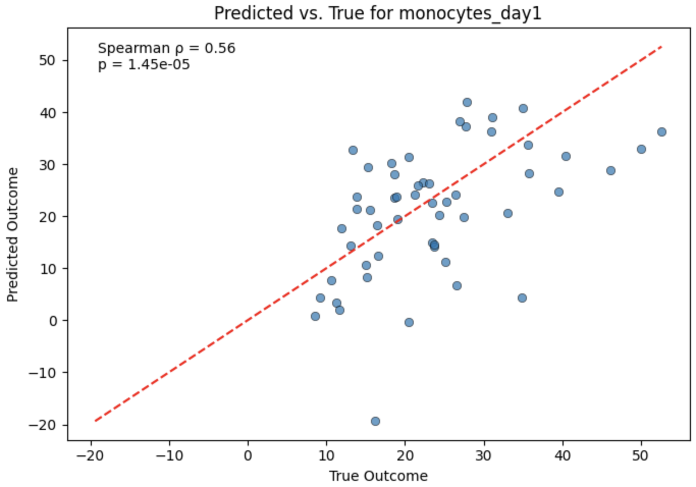

Slide 15
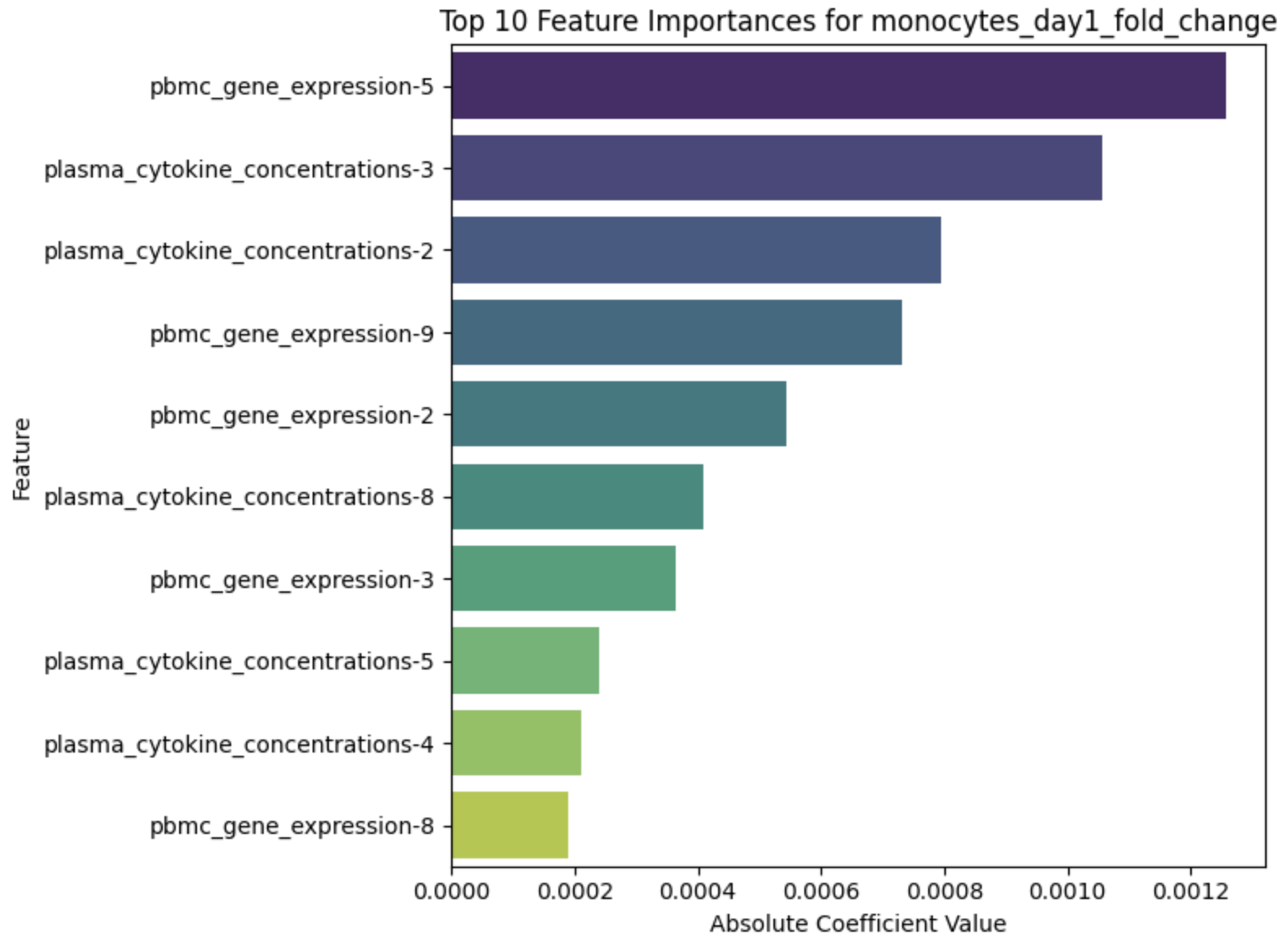

Slide 16
